Slide 1
The Great American Coffee Taste Test
Presented by : Team Data Brew

Slide 2
Why Coffee Dataset?
NIH Survey stats: 75% of adults in USA drink coffee. Almost 50% drink it on daily basis.
Coffee is a significant part of American Culture and Daily life.
Widespread prevalence of coffee consumption makes it an ideal subject for data analysis.
It offers insights into behaviour patterns that affect a large portion of population.

Slide 3
Background
Creator
Rows and Columns
“James Hoffman” and Coffee Company “Cometeer”
4042 Observations
57 Variables
Tidy Tuesady
Data-Set
Online Event
Data types
Youtube Survey
13 Numeric 44 Character

Slide 4
First Question
Why?... Where?... What?... How Much!!! Why do people drink coffee, where do they drink it, what is their roast preference, and how much do they spend on it?

Slide 5
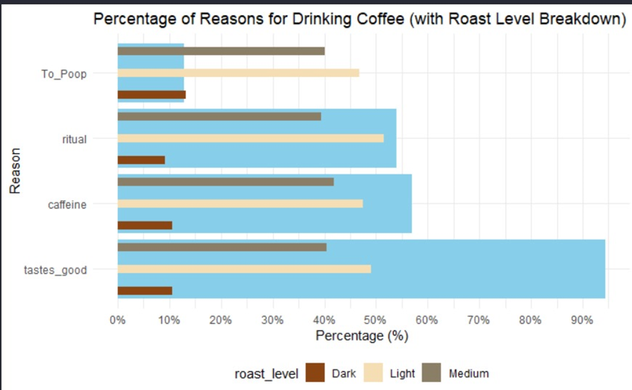
Why People Drink Coffee? What is their Roast Preference?
Most popular reason : “Tastes_good” (94%).
Caffeine (56%) Ritual (54%)
The least common “To Poop” (13%)
Roast Preference” consistent across reasons.
Light” roast - most popular (~50%) and “Dark” Roast least popular (~10%).
Dark Roast for “To_poop”(13%).

Slide 6
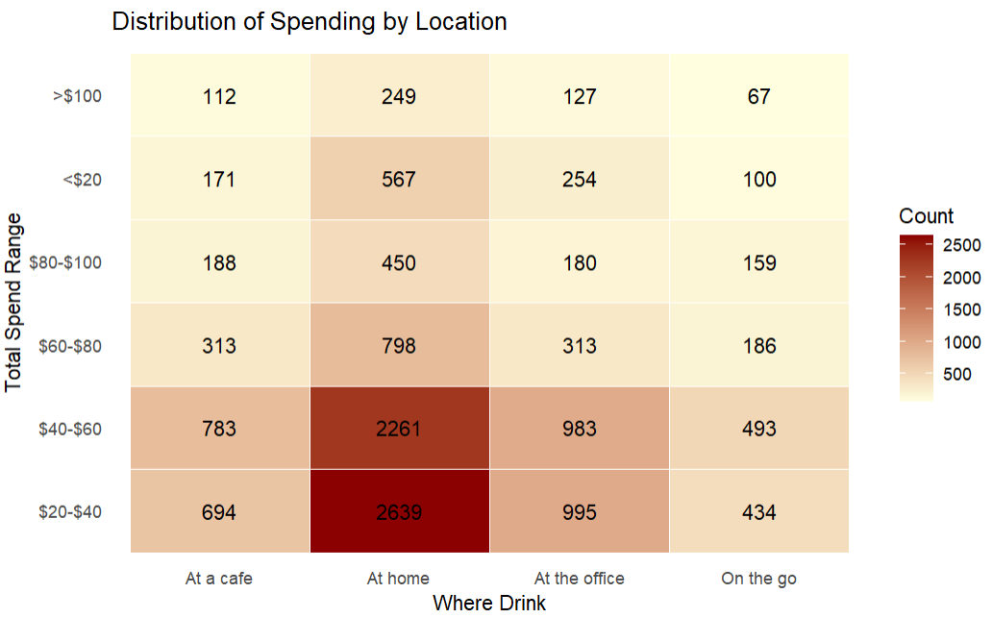
Where People Drink Coffee? How much they spend?
Majority of people drink coffee at home.
most common spending range across all locations is ($20-$60)
Lowest spending range(<$20) and highest (>$100) have fewer people across all locations.
Surprisingly the “at home” category has maximum number of people spending >$100 for coffee.
Possible Reasons: Frequent Consumption, Premium Coffee Beans, or Data Bias .

Slide 7
Second Question
How do age and gender impact preferences for various types of coffee and the use of additives?

Slide 8
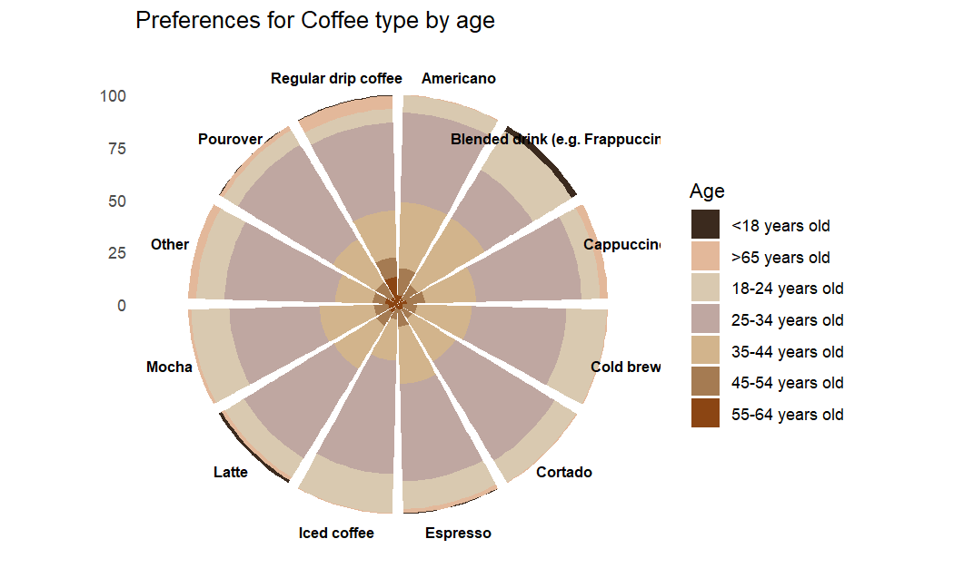
How coffee preference differ among age group?
Regular drip coffee is the most favored across all ages, particularly among older individuals aged 55-64
Younger generation prefer blended drinks, like Frappuccino
Espresso and Latte show balanced appeal across a wide age range
Cold brew, Cortado and Americano are less preferred, with modest popularity in the middle-aged demographic

Slide 9
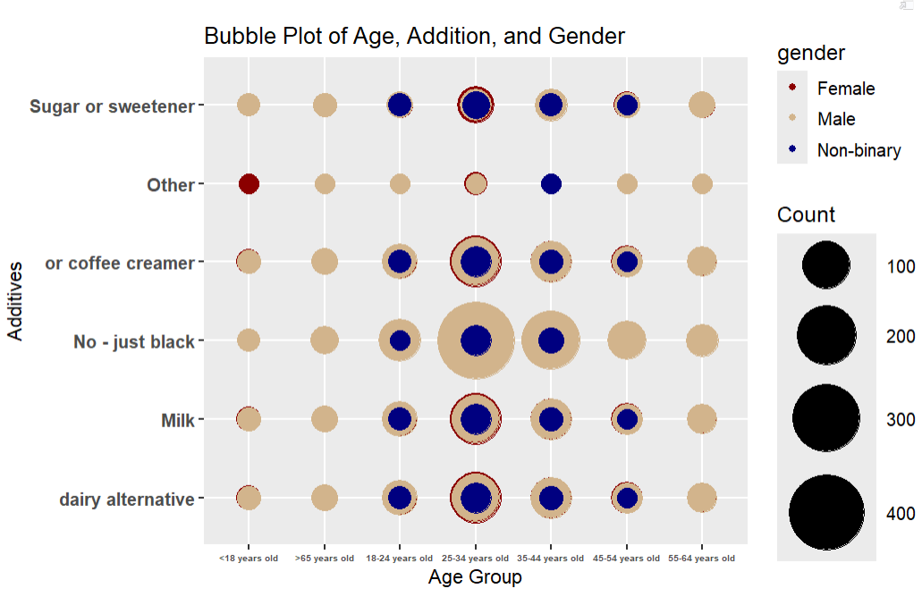
How age and gender influence coffee additives?
Larger bubbles indicate higher counts of individuals who prefer a particular additive
Males under the age group 25-35 years prefer no additives
Sugar or sweeteners and dairy alternatives are less commonly preferred, with a few notable cases among younger and older age groups.
Females show more diverse preferences across additives but with generally lower counts

Slide 10
Conclusion
The primary motivation for coffee consumption is taste, with caffeine being the second most important reason and ritual ranking third.
Light and medium roast coffees are the most preferred among consumers.
A significant portion of respondents (60-70%) drink coffee at home, with spending between $20 and $60 predominantly occurring in this setting.
Regular drip coffee is favored across all age groups, while younger consumers show a preference for blended drinks and Frappuccinos.
Among the 25-34 age group, males predominantly prefer coffee without additives.

Slide 11
Thank you…
We appreciate your patience…

